Slide 1

AMAZON SALES DATA ANALYSIS
This presentation will explore the key insights gained from analyzing Amazon's sales data. We will examine the business problem, the purpose of the project, the data and tools used, as well as findings from product, sales, and customer analyses. Finally, we will provide strategic recommendations to drive future growth.

Slide 2

CONTENTS
Business Problem of project
Purpose of Project
IDE Used and Data Analysis
Product Analysis
Sales Analysis
Customer Analysis
Project Recording
Recommendations
Conclusion

Slide 3
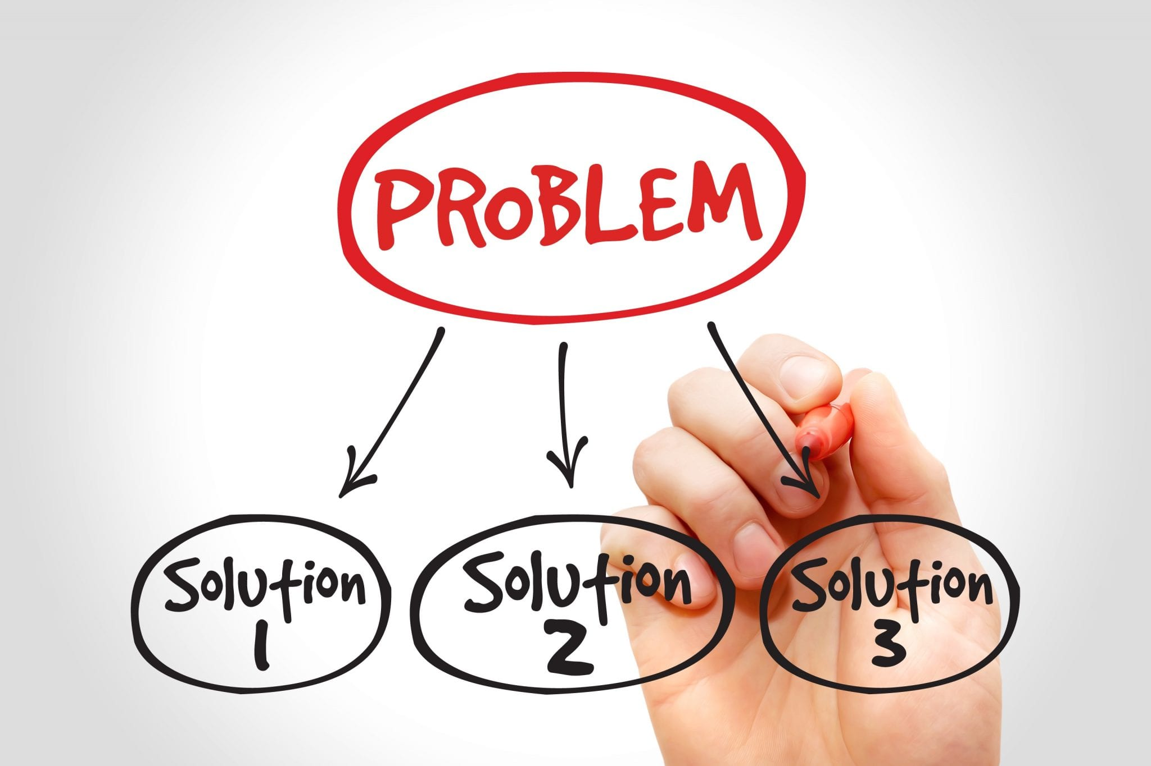
BUSINESS PROBLEM
The primary business problem this project aims to address is understanding the key factors that drive sales performance across Amazon's diverse product offerings and customer base. By identifying the drivers of sales success, we can help Amazon make more informed decisions to boost revenue, improve customer satisfaction, and maintain a competitive edge in the e-commerce landscape.

Slide 4
PURPOSE OF PROJECT
As the company expands its operations, it becomes increasingly challenging to analyze and make sense of the vast amount of sales data generated on a daily basis. Without proper analysis, it becomes difficult to identify trends, make informed business decisions, and maximize profitability.
The purpose of this project is to leverage SQL to provide insights into the company's sales data. By analyzing key metrics, such as sales performance, customer behavior, and product trends, we can identify areas of improvement, optimize sales strategies, and drive business growth.

Slide 5

IDE Used & Data Analysis
We were provided with Amazon's comprehensive sales data, including product lines, customer type, and transaction records.
I've used SQL queries to analyze the data and IDE called Mysql.
We did not have any null values in our dataset, so this enabled efficient analysis and insights generation. Also three new columns were added to understand the sales, revenue in a better way.

Slide 6
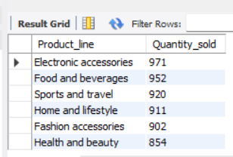
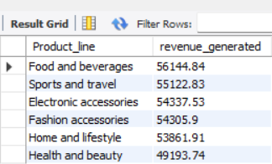
PRODUCT ANALYSIS
There are six different product lines across the dataset. The product line which is performing the best in terms of orders placed is “Fashion accessories”. The product line which is performing poorly is “Health and Beauty” as least number of orders are from this product line.
In terms of gross margin, the highest performing product line is “Fashion accessories” and least profit margin giving product line is “Health and beauty”
Maximum revenue is generated by “Food and Beverages” while “Health and beauty” is minimum revenue generating.
The product line which has highest sales is “Electronic accessories” with a count of 971 quantities sold. “Health and beauty” has least sales compared to all other product lines

Slide 7
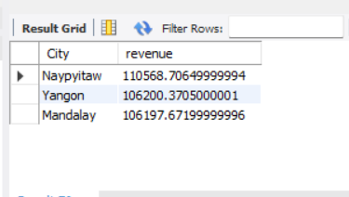
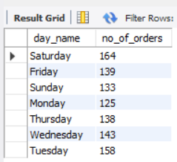
SALES ANALYSIS
We had only three months sales data i.e.January, February and March. On January month highest sales have taken place followed by March and February. On Feb decrease in sales have been observed or there’s fluctuation in sales over all these months.
Maximum revenue is generated on Saturday and that too by the capital city “Naypyitaw”. On Sunday there’s a drastic decrease in sales, even when we compare with weekdays they perform well.

Slide 8
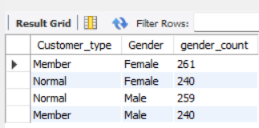
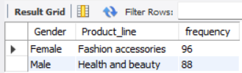
CUSTOMER ANALYSIS
There are two customer segments in the dataset- “Normal” and “Member”.
“Member” customers have high purchase frequency as compared to “Normal” customers.
There are 259 male and 240 female customers in “Normal” customer type
There are 240 male and 261 female customers in “Member” customer type.
Females have more frequently ordered in “Fashion accessories” product line whereas Male are associated with “Health and beauty”
Naypyitaw, city which is generating the highest revenue has more number of female customers than male.(150 male and 178 female)

Slide 9
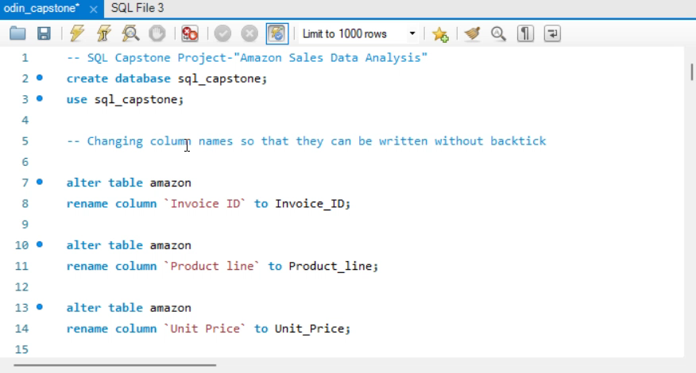
PROJECT RECORDING

Slide 10
RECOMMENDATIONS
Company needs to perform well on “Health and beauty” product line. Necessary measures should be taken to improve the performance of this line. This can be done by adding more products to this line and monitoring sales with those products. They can also give offers or discounts on this product line to increase their sales.
They have to look over their monthly sales as they are decreasing after January. Implement data-driven strategies to optimize sales and inventory management, improving profitability and customer satisfaction.
Develop targeted marketing campaigns and customer loyalty programs to enhance the customer experience and foster long-term relationships.
Leverage insights from the product analysis to fine-tune product offerings, pricing, and marketing strategies to drive sales growth.

Slide 11

CONCLUSION
Gain Valuable Insights
The comprehensive analysis of Amazon's sales data will provide valuable insights to inform strategic decision-making and drive sustainable growth.
Optimize Operations
Implement data-driven recommendations to optimize product offerings, sales strategies, and customer engagement for enhanced performance.
Maintain Competitive Edge
By leveraging the insights from this project, Amazon can maintain a strong competitive position in the dynamic e-commerce landscape.

Slide 12
THANK YOU!

